Slide 1
Penn Prime Air
Matt Schulman
Josh Pearlstein
Steffi Maiman

Slide 2
We Have Focused on Harnessing Optics for Uber-Accurate Landing Capability
Uber-Accurate Landing
Went forward with GPS + Optics Approach
Designed Software System Components
Interfacing with Drone
Recognizing Location of QR Flag/Poster in Image
Algorithm to Update Location of Drone
Integration of Software System Components
Testing and Refinement
Drone Routing

Slide 3
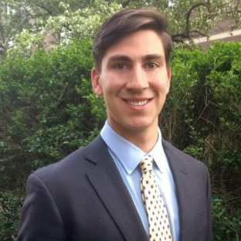
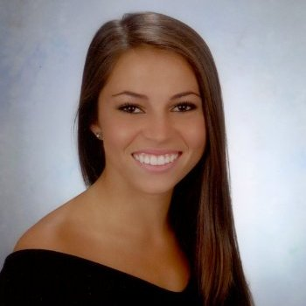
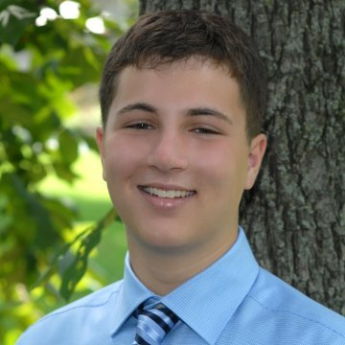
Drone Landing Software Design Flowchart
Determine where the QR code is in the image
Location
of QR Flag
Determine How the Drone Should Move
New
Image
@ New
Altitude
Move Drone
Take New Image
Move
Drone
Command
NO
Landed?
YES
STOP

Slide 4

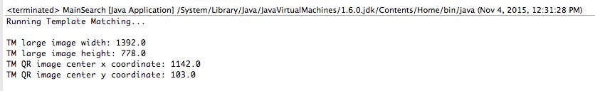
QR Flag Optics Leverages OpenCV Computer Vision
OpenCV: BSD license → free for both academic and commercial use
common infrastructure for computer vision applications
Progress: Template Matching in Java

Slide 5

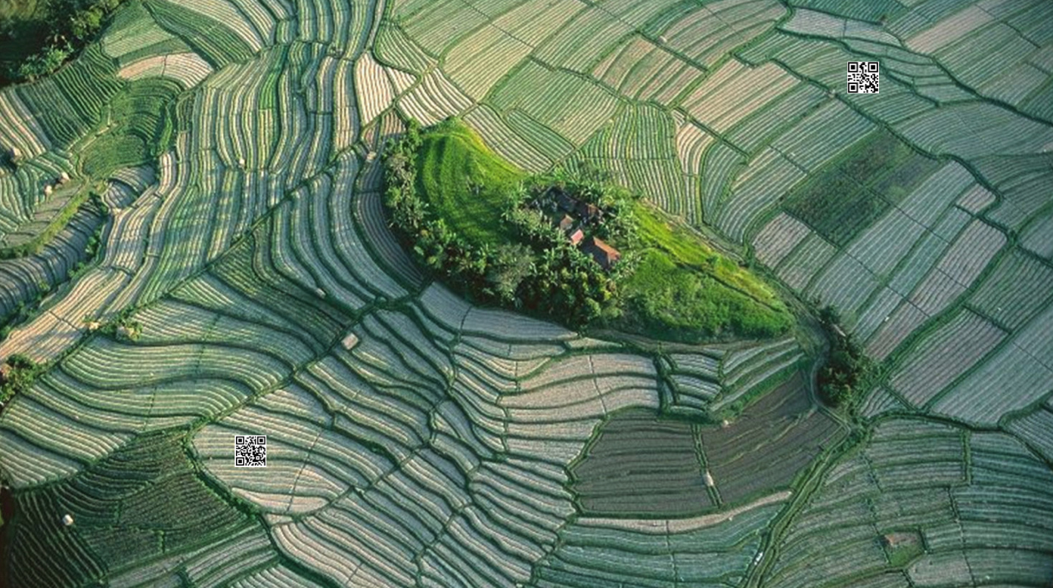
INPUTS:
OUTPUT:
(1142,103)
Template
Source

Slide 6

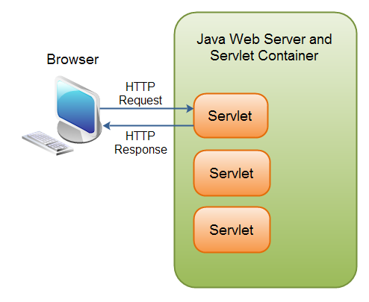
The OpenCV Features2D Framework Will Make the Optics QR Flag Recognition More Robust
1st Next Step: Features2D Framework
“Template matching...is not good when your object is rotated or scaled in scene”
Goals with Features2D Framework
1) Avoid worrying about expected # of pixels in QR code
2) Handle rotated QR codes seamlessly
2nd Next Step: Java Servlet API

Slide 7
Drone Movement Algorithm
Algorithm comprised of 3 components:
Recursive function for movement
Uses a calculated pixel-to-foot ratio
Drone is moved to location above QR code
Lowers drone to proportion of altitude
will be using an experimented zoom ratio (between 0 and 1) depending on the image quality
Landing function
Called when the drone reaches an altitude threshold ~3-5 feet
New Image function
Better accuracy
Process new image at every altitude change
Re-calculate pixel-to-foot ratio

Slide 8
Drone Movement Algorithm Walkthrough Example
Drone Altitude: 100ft
Drone Altitude:
(100*zoomRatio) ft
Original Image:
width = x
height = y
‘Zoomed’ Image:
width = x * zoom
height = y * zoom

Slide 9
Drone Interfacing
Currently interfacing with drone through an iPhone
Next steps include moving that interface to drone hardware
Fully implemented all drone movement
Adding GPS waypoints
Full Gimbal 360 control
Speed, altitude controls
Currently: Drone takes image sends to iPhone which sends to remotely hosted image processing server which sends results back to iPhone for control commands
Next steps: Drone takes image, processes on board, decides which commands to take

Slide 10
High Level Next Steps
Integration of Software System Components
Refine Optic Component
Template Matching → Feature2D
Rotated Images Compatibility
Java Servlet API for Optic Component
N64 → image conversion
QR creation from QR code
Possibly look into writing optics openCV algorithm in ios app to avoid API calls
Test with Drone
Integration pains?
Ideal magnitude of Drone movement commands (tradeoff between speed & accuracy)
Refinement of Drone movement algorithm
Testing and Refinement
Drone Routing

